Slide 1
Core& Contracts Training
Part 1: Essentials
January 2020

Slide 2
What are the Core& Contracts?
Core& One | Core& Combined
Low risk procurement ≤$500,000 excluding GST Procurement of ONE of the following ICT Solutions: Hardware Software As-A-Service Professional Services | Low risk procurement ≤$500,000 excluding GST Procurement of TWO OR MORE of the following ICT Solutions: Hardware Software As-A-Service Professional Services

Slide 3
When can I use the Core& Contracts?
PBD 2018-02 mandates the use of the Core& Agreement
This has been revised and renamed as the Core& Contracts
The Core& Contracts are to be used for:
Low-risk procurements
Up to $500,000 excluding GST
For guidance on how to assess the risk of procurements, please download the ‘Risk Assessment Toolkit’ here
If the procurement falls outside the risk and contract value for the Core& Contracts, please use the Procure IT v3.2 contract

Slide 4
ICT Services Scheme
Mandatory whole of government prequalification schemes as per PBD 2019-04
Suppliers must register and be prequalified on the ICT Services Scheme before supplying ICT goods and services to NSW government agencies

Slide 5
Solution Requirements
Professional Services
Hardware
Software
As-A-Service

Slide 6
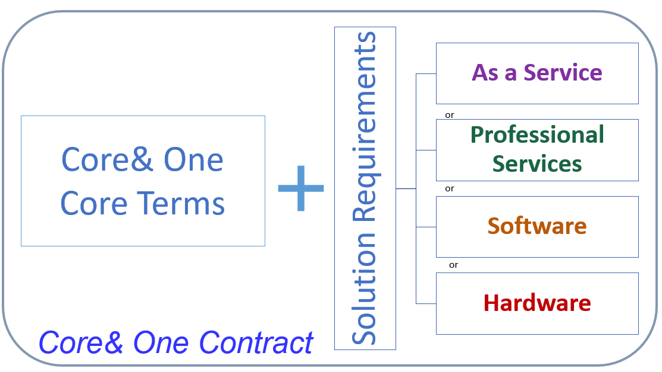
Core& One
This template should only be used when procuring an individual solution
Do not complete the Solution Requirements that are not relevant to your procurement

Slide 7
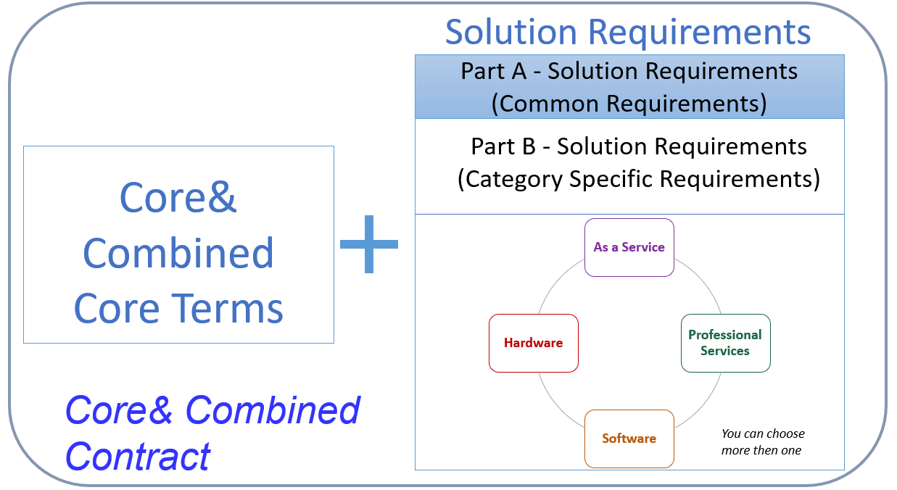
Core& Combined
This template should only be used when procuring multiple solutions
Only fill out the Solution Requirements that are relevant to your procurement
If you are not using some of the solution requirements, you may delete them

Slide 8
Can I vary the terms in the Core& Contracts?
Beneficial variations can be varied without approvals
Non-beneficial variations will need to be endorsed by your Agency in-house Legal team. DCS Legal will need to be briefed of the proposed variations and be provided with a risks analysis
DCS Legal will then request the Government Chief Information and Digital Officer to approve the variations on behalf of the Procurement Board

