Slide 1
Core& Contracts Training
Part 2: Case Studies
January 2020

Slide 2
Case Study 1
You wish to purchase a cloud based expense management system. Vendor ABC Pty Ltd has a competitive price and a tailored offering called EMS 1.0. ABC Pty Ltd will store the data in NSW and the EMS 1.0 will not be handling “Personal Information”. They have quoted you $400,000 excluding GST. There will be an option to extend the contract for one year for $50,000.

Slide 3
Case Study 1
Is the vendor registered on the ICT Services Scheme?
Download the Excel spreadsheet listing all suppliers on the ICT Services Scheme webpage. Check if ABC Pty Ltd are registered as an Advanced Registered Supplier
If YES, then you can proceed to the next step
If NO, then ABC Pty Ltd must register for prequalification on the ICT Services Scheme on eTendering here

Slide 4
Case Study 1
2. Is the procurement low-risk and under $500,000 excl GST?
The total contract value is $450,000
Please follow your internal policies and procedures regarding risk. The Risk Assessment Toolkit can be used as a guide
For example, the EMS 1.0 stores the data within Australia and does not rely on personal information. This is potentially one indicator of a low-risk procurement

Slide 5
Case Study 1
3. Which Core& Contract do I use?
As there is only one ICT solution, use the Core& One contract
4. What do I need to include in the Core& One contract?
Core& One Core Terms (incorporated by reference) and
As-A-Service Solution Requirement

Slide 6
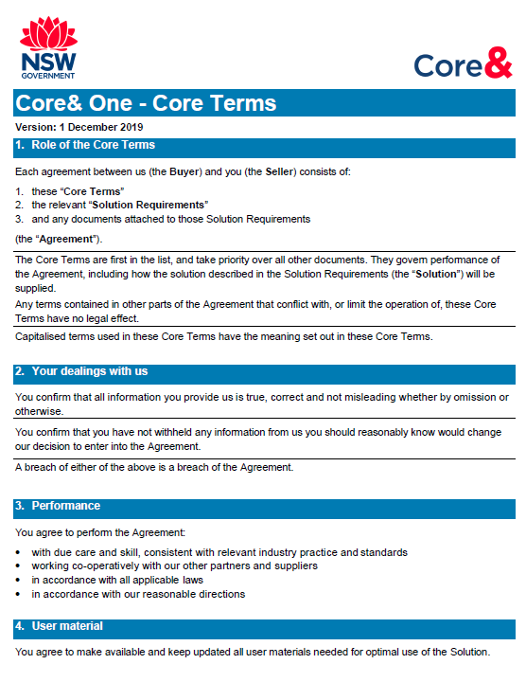
Core& One Core Terms

Slide 7
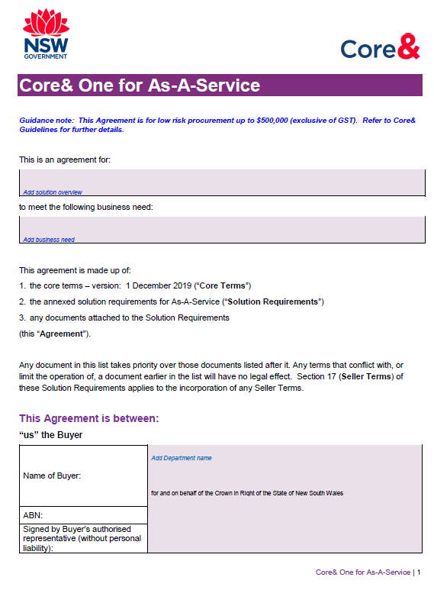
Core& One Solution Requirement: As-A-Service

Slide 8
Case Study 2
Your agency is undergoing a digital transformation of its outdated records management system. This will be an “off-premise” service. You have chosen ICT Pty Ltd as their RMS 1.0 solution presents the most value for money. Due to the complexity of RMS 1.0, you will need the ICT Pty Ltd specialists to implement the system. No data will be stored overseas and the agency’s critical functions will not be affected . You have negotiated a final price of $200,000 excluding GST for the RMS 1.0 solution and implementation, with an option to extend for 1 year for $100,000.

Slide 9
Case Study 2
1. Is the vendor registered on the ICT Services Scheme?
Download the Excel spreadsheet listing all suppliers on the ICT Services Scheme webpage. Check if ICT Pty Ltd are registered as an Advanced Registered Supplier
If YES, then you can proceed to the next step
If NO, then ICT Pty Ltd must register for prequalification on the ICT Services Scheme on eTendering here

Slide 10
Case Study 2
2. Is the procurement low-risk and under $500,000 excluding GST?
The total contract value is $300,000 excluding GST
As the data is stored in Australia and the solution does not affect the agency critical functions, this may be indicative of a low risk procurement.
Please refer to internal policies to comprehensively assess the risk of the procurement

Slide 11
Case Study 2
3. Which Core& Contract do I use?
There are 2 solutions:
As-A-Service
Professional Services
As such, the Core& Combined contract is suitable

Slide 12
Case Study 2
4. What do I need to include in the Core& Combined contract?
Core& Combined Core Terms (incorporated by reference)
Solution Requirements which contains:
Part A Common Requirements
Part B Category Specific Requirements for As-A-Service and Professional Services

Slide 13
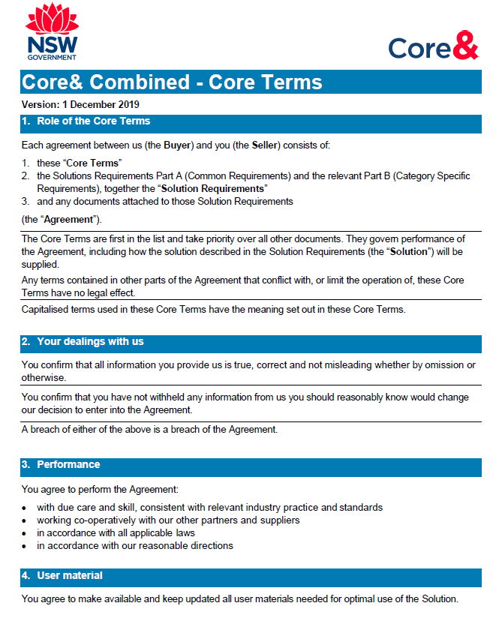
Core& Combined Core Terms

Slide 14
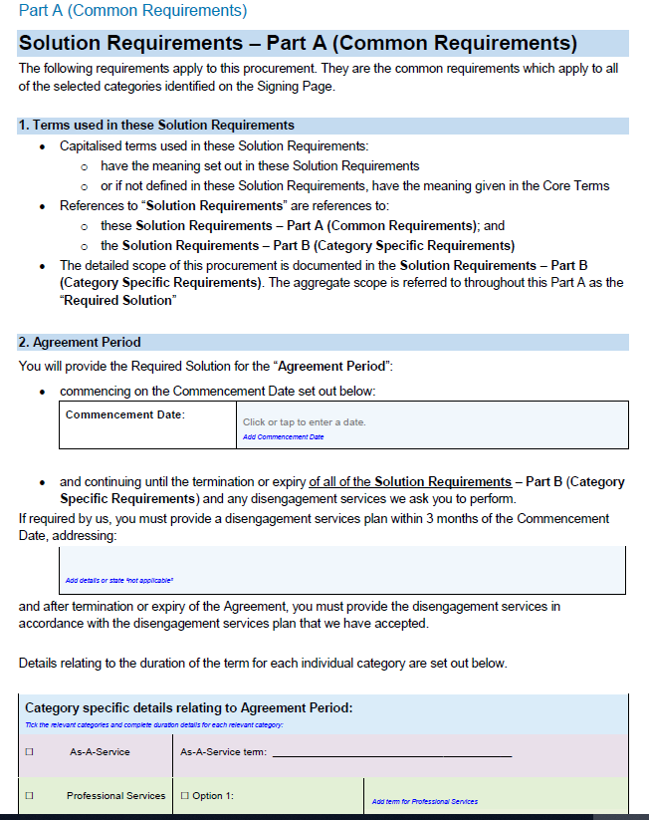
Part A: Common Requirements

Slide 15
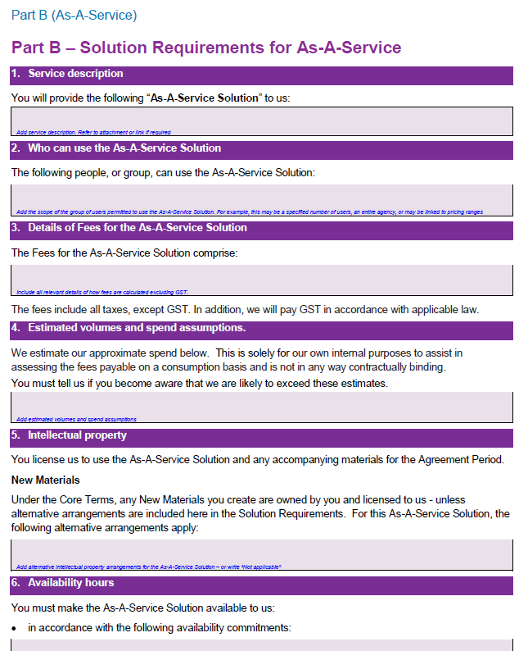
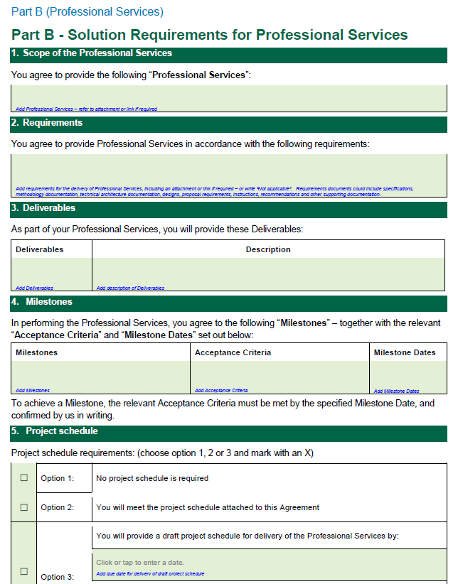
Part B: Category Specific Requirements

