Slide 1
PMS scheme guide to modify existing applications
November 2022

Slide 2
Introduction
Purpose of this document
This slide pack has been designed to help current Performance and Management Services Scheme (PMSS) suppliers with modifying their applications.
All scheme suppliers can apply to modify their current applications at any time during the scheme’s duration.
This document will look at these types of modification:
Changing ABN or merging scheme-registered entities
Adding new capabilities and engagement types (Base prequalification)
Adding new capabilities and engagement types (Full prequalification)
Upgrading from Base to Full prequalification
Basic checks for Referee Reports (Full prequalification)

Slide 3
1. Changing ABN or merging scheme-registered entities

Slide 4
Essentials
What you need to do
Email pms@treasury.nsw.gov.au with a brief description of your organisation’s circumstances.
Attach any documents relevant to your request, such as:
official ASIC certification
a signed letterhead officially documenting your request
an overview of your organisation’s overarching corporate structure.
A member of the team will reply to your email with clarification questions or instruct you to submit a modification request through eTendering.

Slide 5
2. Adding new capabilities and engagement types (Base prequalification)

Slide 6
Essentials
What you need do to and check
Have the following ready to upload in reference to new engagement types you want to add to your application:
Updated Company Profile noting work experience in additional engagement types
Updated Organisational Experience
Updated Rate Card for any engagement types in 14. Specialised Services
Refer to the Additions to current Base checklist and Step by Step guide to modifying an application before submitting your application to modify.
You must only nominate additional capabilities that your business provides and for which you can provide some form of supporting evidence for assessment in the application (see opposite).
Nominated capabilities
Organisational Experience
Example Engagement
Example Engagement
Example Engagement
Your updated Organisational Experience template only needs to refer to new engagement types you want to add.

Slide 7
3. Adding new capabilities and engagement types (Full prequalification)

Slide 8
Essentials
What you need do to and check
Have the following ready to upload in reference to new engagement types you want to add to your application:
Updated Company Profile noting work experience in additional engagement types
Updated Organisational Experience template
At least three Referee Reports
Updated Rate Card for any engagement types in 14. Specialised Services
Refer to the Additions to current Full checklist and Step by Step guide to modifying an application before submitting your application to modify.
You must only nominate capabilities that your business provides and for which you can provide some form of supporting evidence for assessment in the application.
Nominated capabilities
Organisational Experience
Example Engagement
Example Engagement
Example Engagement
Referee Report
Referee Report
Referee Report

Slide 9
Infrastructure Advisory Contract Framework
For engagements of infrastructure advisory services under engagement type 15
For engagements of infrastructure advisory services under engagement type 15, there is an IA contract framework that government agencies are recommended to use when awarding contracts to infrastructure advisory suppliers.
The IA contract framework includes contract templates and tools for a standardised approach to risk allocation when buying infrastructure advisory services.
More information on this framework is available on the infrastructure advisory services category page.
IA Contract Framework

Slide 10
4. Upgrading from Base to Full prequalification

Slide 11
What will Full prequalification mean for you?
A brief overview
 | Base | Full
Maximum engagement value (ex GST) | $50,000 | No limit
Engagement risk level | Low-risk only | Low and high risk
Minimum insurance requirements for each PMSS engagement | Workers Compensation Where applicable: Public liability – $5 million Professional indemnity - $2 million (and no more than $10 million) | Workers Compensation Where applicable: Public liability – $10 million Professional indemnity - $10 million or per an approved scheme under the Professional Standards Act
Additional application requirements | Not applicable | x 3 Referee Reports as evidence of nominated capabilities
Level of assessment | Eligibility assessment | Detailed evaluation
Under Full prequalification, you will be able to undertake higher value and higher risk work.
You do not need to have the minimum insurances when applying but you will need them if engaged by a NSW Government agency through the scheme.
See table opposite for a brief overview of the levels.

Slide 12
Essentials
What you need do to
You will need to submit a new application to the scheme under Full prequalification. Any pre-existing Base capabilities will not be carried over and you will need to re-apply for them as part of the new application.
Refer to the PMS scheme application guide for new applicants for a refresher on application requirements and specific advice applying for Full prequalification.
Only nominate additional capabilities that your business provides and for which you can provide some form of supporting evidence for assessment in the application (see opposite).
NOTE: Referee Reports must correspond to a nominated example engagement and refer to the same nominated capabilities in that example.
Nominated capabilities
Organisational Experience
Example Engagement
Example Engagement
Example Engagement
Referee Report
Referee Report
Referee Report

Slide 13
5. Referee Reports (Full prequalification ONLY)

Slide 14
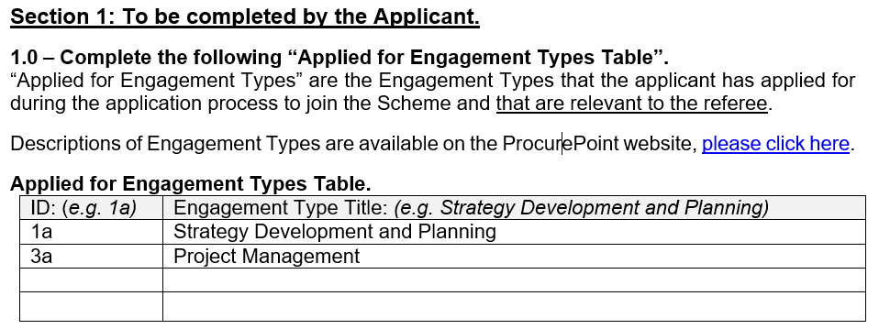
What should be in a Referee Report
Basic inclusions – Section 1
Capabilities you have nominated in your application must correspond to a Referee Report – in other words, please ensure that each of your capabilities is supported by at least one Referee Report.
A single Referee Report does not need to cover all nominated capabilities

Slide 15
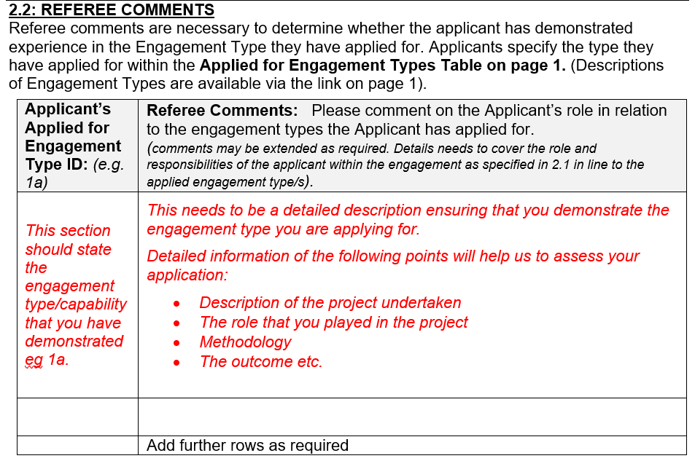
What should be in a Referee Report
Basic inclusions – Section 2.2
Pre-fill capabilities you listed in Section 1 for the Referee’s comments where the purple box is. Using the the example in the previous slide, you would insert 1a and 3a.
You may choose to allocate one capability per row or combine complementary capabilities for the Referee’s comments.

Slide 16
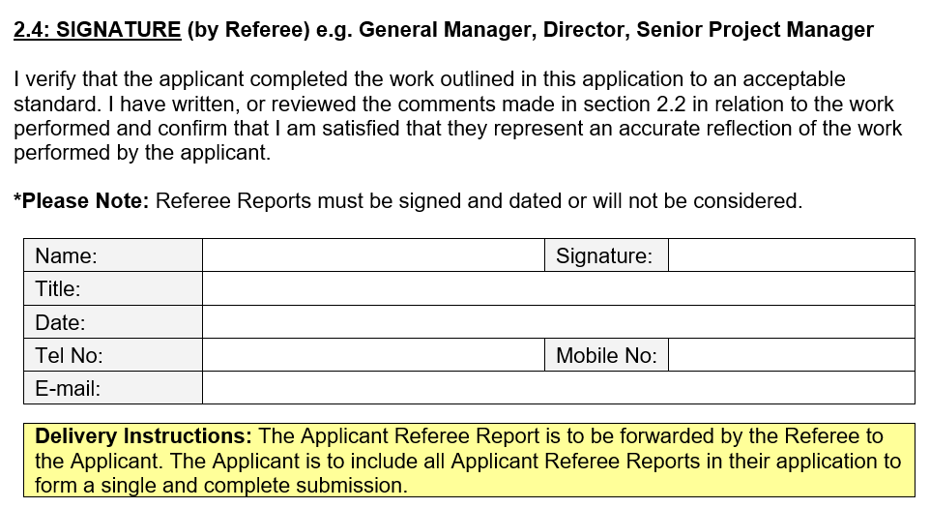
What should be in a Referee Report
Basic inclusions – Section 2.4
Check that your Referee Report has been correctly signed and dated.
Signatures or e-signatures only – reports signed with printed names will be rejected
All reports must be dated

