Slide 1
PMS scheme guide to new applications
November 2022

Slide 2
Introduction
Purpose of this document
This slide pack has been designed to help new applicants with their applications to prequalify for the Performance and Management Services Scheme (PMSS).
This document will look at these specific parts of the PMSS application:
Choosing a prequalification level
Nominating capabilities and engagement types
Providing evidence of organisational experience
Basic checks for Referee Reports (Full prequalification ONLY)
Complementary schemes for IT or Infrastructure-related suppliers

Slide 3
1. Choosing a prequalification level

Slide 4
PMSS prequalification levels
What are they and why do they matter?
 | Base | Full
Maximum engagement value (ex GST) | $50,000 | No limit
Engagement risk level | Low-risk only | Low and high risk
Minimum insurance requirements for each PMSS engagement | Workers Compensation Where applicable: Public liability – $5 million Professional indemnity - $2 million (and no more than $10 million) | Workers Compensation Where applicable: Public liability – $10 million Professional indemnity - $10 million or per an approved scheme under the Professional Standards Act
Additional application requirements | Not applicable | x 3 Referee Reports as evidence of nominated capabilities
Level of assessment | Eligibility assessment | Detailed evaluation
Two types of prequalification – Base and Full.
Prequalification level determine what types of work and the maximum engagement value of any work you may perform under the scheme.
You do not need to have the minimum insurances when applying but you will need them if engaged by a NSW Government agency through the scheme.
See table opposite for a brief overview of the levels.

Slide 5
Selecting a prequalification level
Questions to guide you in choosing the most appropriate prequalification level
Consider the following questions for your business in terms of a ‘yes’ or ‘no’ response:
Is it a new with limited work experience?
Would it be difficult to provide at least three different written references for work that you or other key personnel have performed?
Is the average engagement value for recent works less than $50,000 (ex GST)?
Would it be difficult to maintain the minimum insurance requirements for each engagement (see previous slide)?
If you mostly answered ‘yes’ – consider applying for Base level.
If you mostly answered ‘no’ – consider applying for Full prequalification.

Slide 6
2. Nominating capabilities and engagement types

Slide 7
Capabilities and engagement types
What are they and why do they matter?
Capabilities
Government & Business Strategy
Financial Services
Audit, Quality Assurance and Risk
Marketing and Customer
Operations Business Processes Project Management Change Management Human Resources Procurement & Supply Chain
Transaction, Actuarial, Taxation Taxation Actuarial Transaction services
Specialised Services
Infrastructure Services
The terms ‘capabilities’ and ‘engagement types’ are used interchangeably in the application process. They refer to broad categories of work that your business ‘signs up’ to provide NSW Government agencies through the scheme.
You must only nominate capabilities that your business provides and for which you can provide some form of supporting evidence for assessment in the application.
Capabilities identified in the diagram opposite are subject to the mandated Standard Commercial Framework for engagement types 1-12. Engagement type 15 ‘Infrastructure services’ is subject to the recommended Infrastructure Advisory Standard Commercial Framework (IA SCF) Engagement type 14 ‘Specialised Services’ is not subject to any commercial framework. If you are offering services within this capability, you must submit a daily rate card in the prescribed template.
Standard Commercial Framework applies
Daily rates required
IA
SCF
applies

Slide 8
Selecting capabilities
Specifying capabilities you can offer through the scheme
You must identify specific engagement types (see examples in green opposite) in your application for assessment. The full list of engagement types is available here.
TIP: You should first consider engagement types under 15. Infrastructure if your business:
is in an infrastructure-related field like urban/transport planning, architecture, commercial property, or
frequently performs work, e.g. risk/ project management, in an infrastructure context.
Is not an ICT related service provider
5. Financial Services
Operations
15. Infrastructure
8. Human Resources
5d – Asset Management
15a - Strategy & Planning
8b - Culture

Slide 9
Impact of capability choice
Daily rates for any nominated capabilities in 14. Specialised Services
You must completed and submit a Rate Card if you are nominating capabilities falling under Specialised Services.
Provide a daily rate as indicated in the template. Use the drop down list in the template (see opposite) to specify the engagement type.
Do not include engagement types you have not nominated and supported in your application.

Slide 10
Impact of capability choice
What nominating capabilities means for your application
Nominated capabilities must flow through to your Organisational Experience document (see diagram opposite) to demonstrate work you have performed in these areas.
For example, if you nominate specific engagement type 1a, then one of your example engagements must refer to 1a.
If applying for Full prequalification – your Referee Reports must correspond to a nominated example engagement and refer to the same nominated capabilities in that example.
Nominated capabilities
Organisational Experience
All applications
Example Engagement
Example Engagement
Example Engagement
Full prequalification only
Referee Report
Referee Report
Referee Report

Slide 11
3. Providing evidence of organisational experience

Slide 12
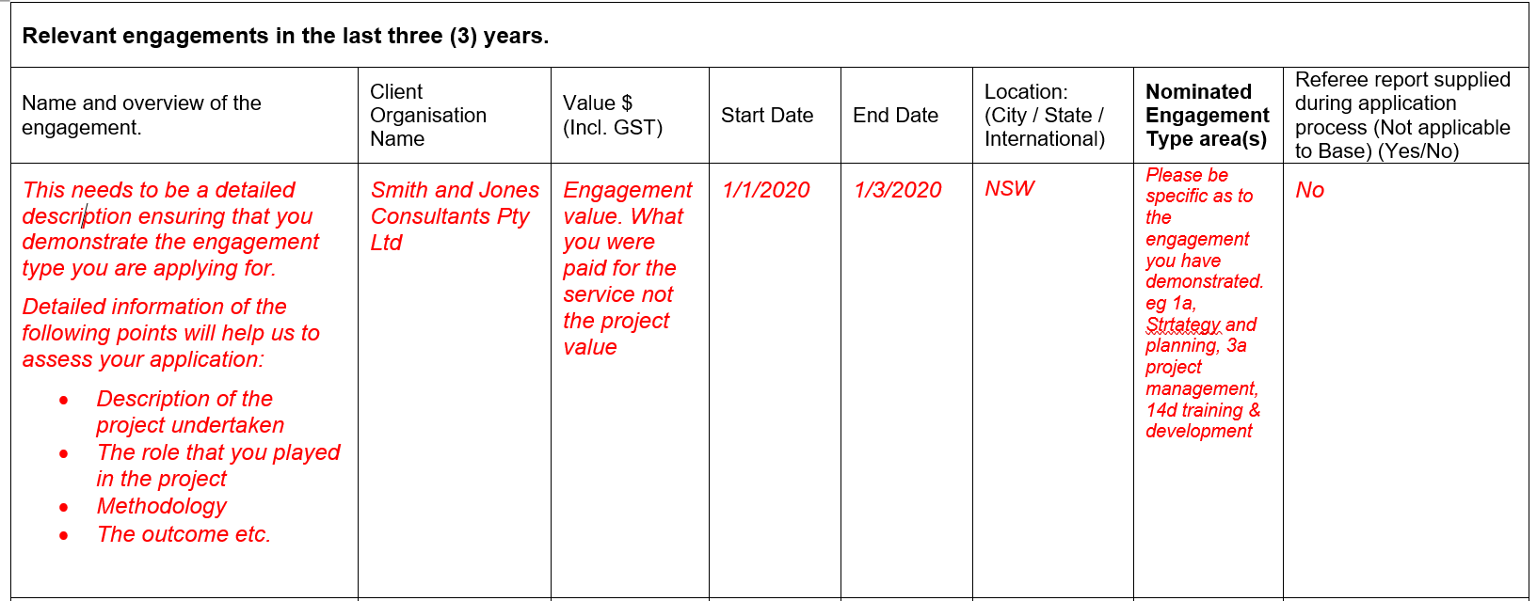
Tips for all applicants
You must complete the prescribed template (screenshot below) and pay particular attention to the red text.
All Full prequalification applicants must identify at least three engagements, by stating ‘yes’ where the purple box is, to support with a corresponding Referee Report.

Slide 13
4. Basic checks for Referee Reports (Full prequalification ONLY)

Slide 14
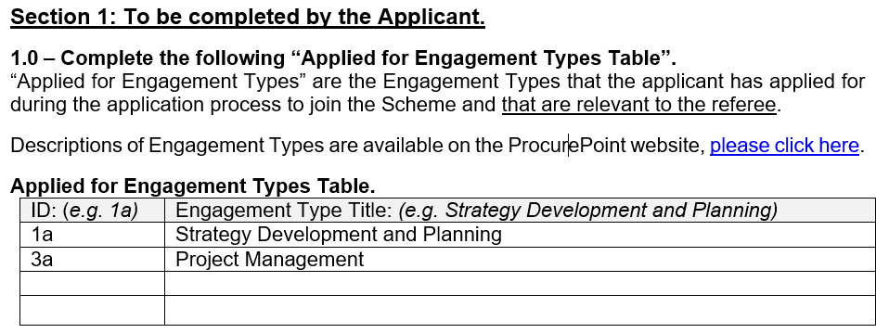
What should be in a Referee Report
Basic inclusions – Section 1
Capabilities you have nominated in your application must correspond to a Referee Report – in other words, please ensure that each of your capabilities is supported by at least one Referee Report.
A single Referee Report does not need to cover all nominated capabilities

Slide 15
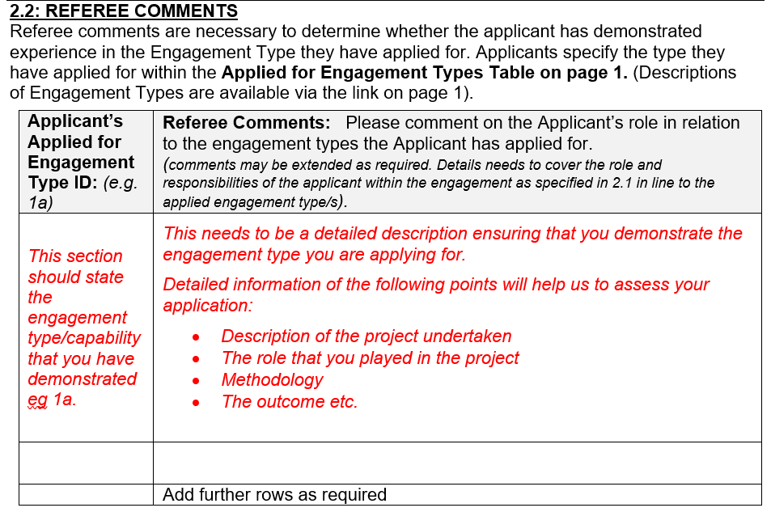
What should be in a Referee Report
Basic inclusions – Section 2.2
Pre-fill capabilities you listed in Section 1 for the Referee’s comments where the purple box is. Using the the example in the previous slide, you would insert 1a and 3a.
You may choose to allocate one capability per row or combine complementary capabilities for the Referee’s comments.

Slide 16
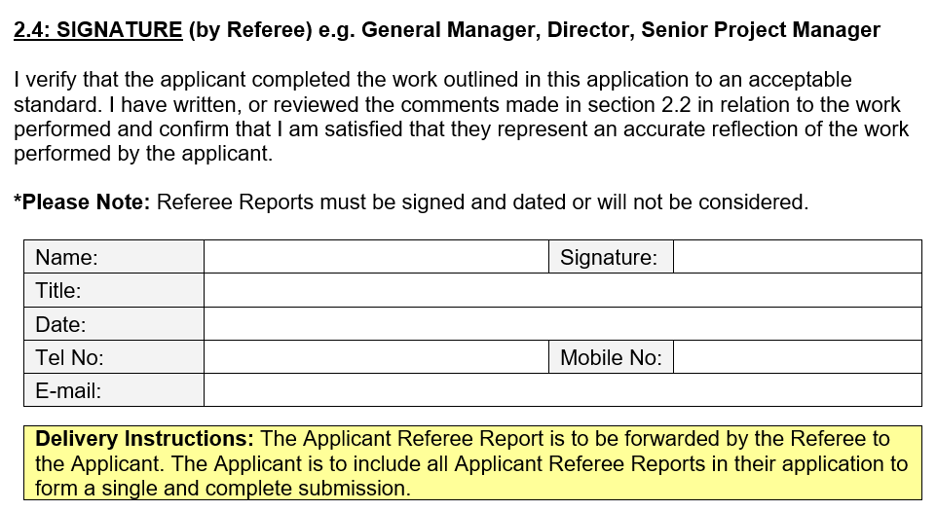
What should be in a Referee Report
Basic inclusions – Section 2.4
Check that your Referee Report has been correctly signed and dated.
Signatures or e-signatures only – reports signed with printed names will be rejected
All reports must be dated

Slide 17
5. Complementary schemes for IT and infrastructure-related suppliers

Slide 18
Complementary NSW Government buying arrangements
Click on the schemes for further information
Do you work in an IT or infrastructure space?
IT
Infrastructure
ICT Services Scheme
Consultants in Construction Scheme
Mandated for all NSW Government agencies
17 categories you may register under
IT-specific contract templates
Managed by Digital.NSW
Recommended for all NSW Government agencies
Five categories: project management, planning, engineering, architectural and assessment
Managed by the Public Works Advisory

