Slide 1
Prequalification Scheme: NSW Government Electric Vehicle Fleet Charging Infrastructure – SCM13381 Guide for scheme applicants
January 2023

Slide 2
Introduction
Purpose of this document
This document has been designed as a simple guide to help new applicants with their applications to prequalify for the NSW Government Electric Vehicle Fleet Charging Infrastructure – SCM13381 (“scheme”).
The document covers the following areas;
Outline for prequalification to "Capability A" under the scheme
Eligibility and requirements to apply and be prequalified on the scheme
Guide notes and watchpoints for applicants to in addressing each prequalification question.
This document should be read in conjunction with the scheme conditions and all other scheme documents.
Please note the images listed in this guide are captured from the templates to be completed and documents in corresponding sections of scheme application in NSW buy.nsw website.

Slide 3
1. Prequalification under “Capability A” on the scheme

Slide 4
Prequalification capability under the scheme
The scheme has one (1) prequalification capability referred to as capability A.
To prequalify under capability A, applicants must:
Demonstrate the ability to deliver the full scope defined under A1+A2+A3, (A4 Optional) and EVSE specifications under the scheme, either directly, or via the engagement of sub-contractors for whom the approved supplier remains responsible for.
Please carefully read the full contexts of capability A – Electric Vehicle Supply Equipment Goods, Works and Services, the scheme rules, terms and resources in buy.nsw website:
Electric Vehicle Fleet Charging Infrastructure Scheme | info.buy.nsw

Slide 5
2. Eligibility to apply for prequalification on the scheme

Slide 6
ABN and Trust Arrangements
Applicant must be aware of the eligibility requirements to be included on the scheme.
Applicants must have a current Australian Business Number (ABN) and/or an Australian Company Number (ACN) and be registered for the Goods and Services Tax (GST).
Applicant can be a Trustee (e.g. Trustee for the Smith Family Trust)
X Trusts (e.g. Smith Family Trust) are not eligible

Slide 7
3. Application Questionnaire

Slide 8
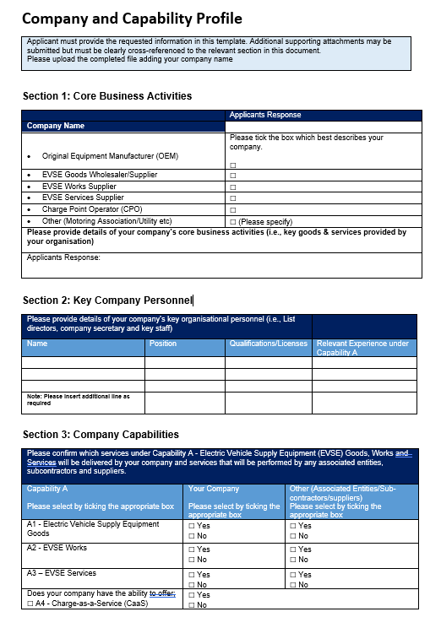
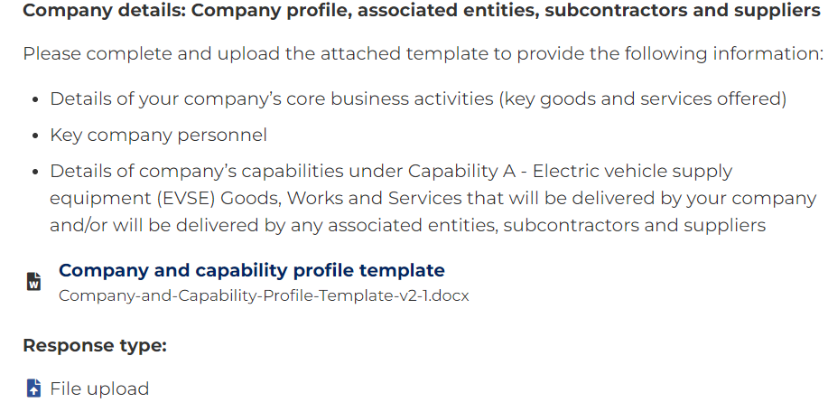
Company details: Company profile, associated entities, subcontractors and suppliers
The applicant must provide details of their company capability to deliver the complete scope of requirements under capability A; (A1+A2+A3, (A4 Optional) as per the EVSE specification document, either directly or via the engagement of 3rd parties.
2
Guide Note for completing Company and Capability Profile template
1
Core business activities must be well described and outline how the good and/or service offered align with the capability A requirements under the scheme.
4
5
Your company must have ability to deliver the full scope of requirements under capability A – that is A1,A2,A3, (A4 Optional), either directly, or via the engagement of sub-contractors.
(Please ensure you select A1,A2,A3 (A4 if you have the capability.
Please select Yes/or No to indicate which part of capability A will be delivered by your company or via the engagement of 3rd parties.
3
4
6
Guide note for Question – Company Details
1
Review the requirements detailed in the question.
Watchpoint:
Applicants who have not indicated that they have the capability to deliver the complete scope of requirements under capability A (A1+A2+A3, (A4 Optional), either directly or via the engagement of 3rd parties will be marked unsuccessful.
2
Complete the Company and Capability profile template
3
Upload the completed template.
5
6

Slide 9
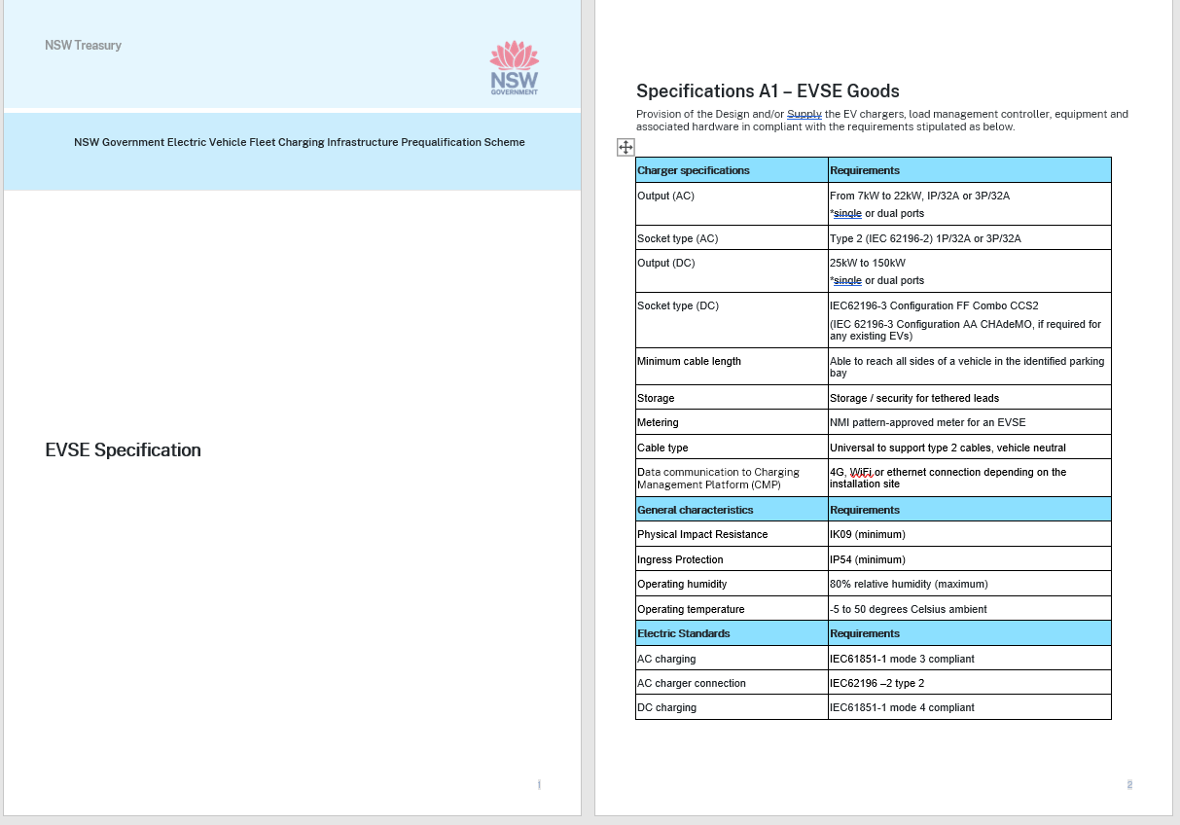
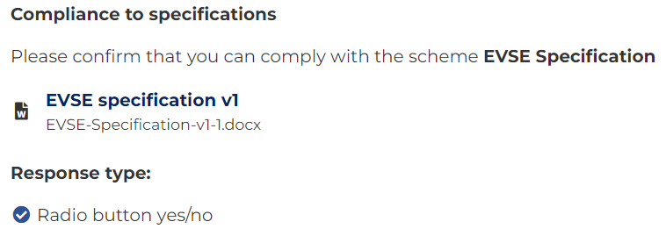
Compliance to Specification
The applicant must comply with the EVSE specification and be able to deliver the complete scope of requirements under capability A; (A1+A2+A3, (A4 Optional), either directly or via the engagement of 3rd parties.
Guide note for Question
1
Download the EVSE Specifications document and ensure you review all requirements
2
Select yes or no to confirm whether you can comply to the EVSE specifications relating to capability A.
1
2
1
Watchpoint:
Applicants who have not indicated that they can comply with the EVSE specification will be marked as unsuccessful

Slide 10
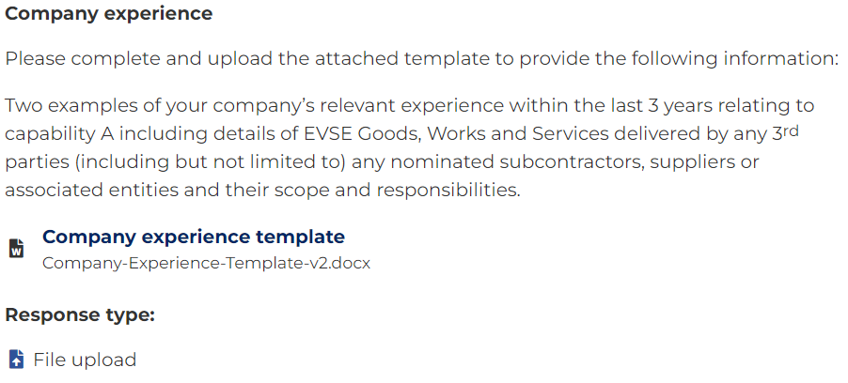
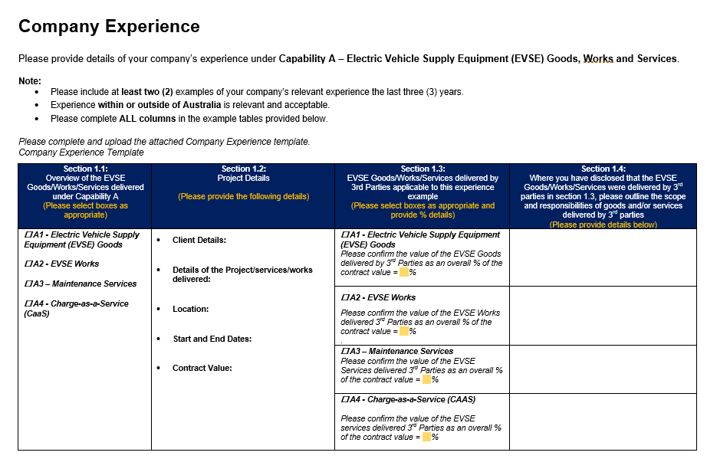
Company Experience
The applicant must be able to demonstrate previous project experience where they have delivered the full scope of
requirements under capability A, either directly or via 3rd parties.
1
1
Guide Note for completing Company Experience template
3
You must demonstrate that your company has delivered the full scope of Capability A either by itself or via 3rd parties. If this is the case please ensure you indicate this by selecting A1/A2/A3 (A4 is optional) in Section 1.1.
2
4
You must provide details of the reference project in section 1.2. Ensure that details provide some insight in how they relates to capability A.
5
Only select the scope of the project that was delivered by 3rd parties and indicate the % of the overall contract value.
3
4
6
Guide note for Question Company Experience
5
Provide as much details as possible about the scope and responsibilities delivered by 3rd party and how that relates to capability A.
6
1
Review the requirements detailed in the question. Download and complete the Company Experience template.
2
Upload the completed template.
Watchpoint:
Applicants that do not provide a complete response, or information in the form requested that successfully demonstrates previous project experience to deliver the full scope of requirements under capability A, either directly of via 3rd parties will be marked unsuccessful.

Slide 11
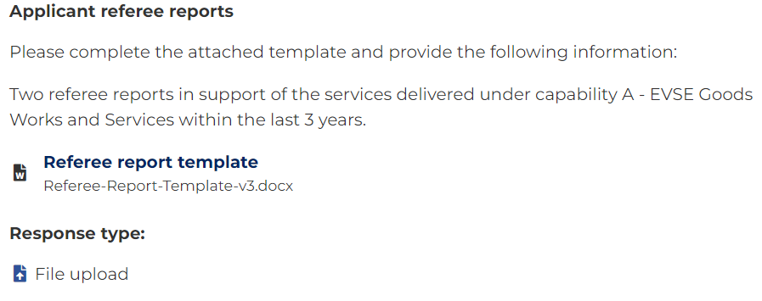
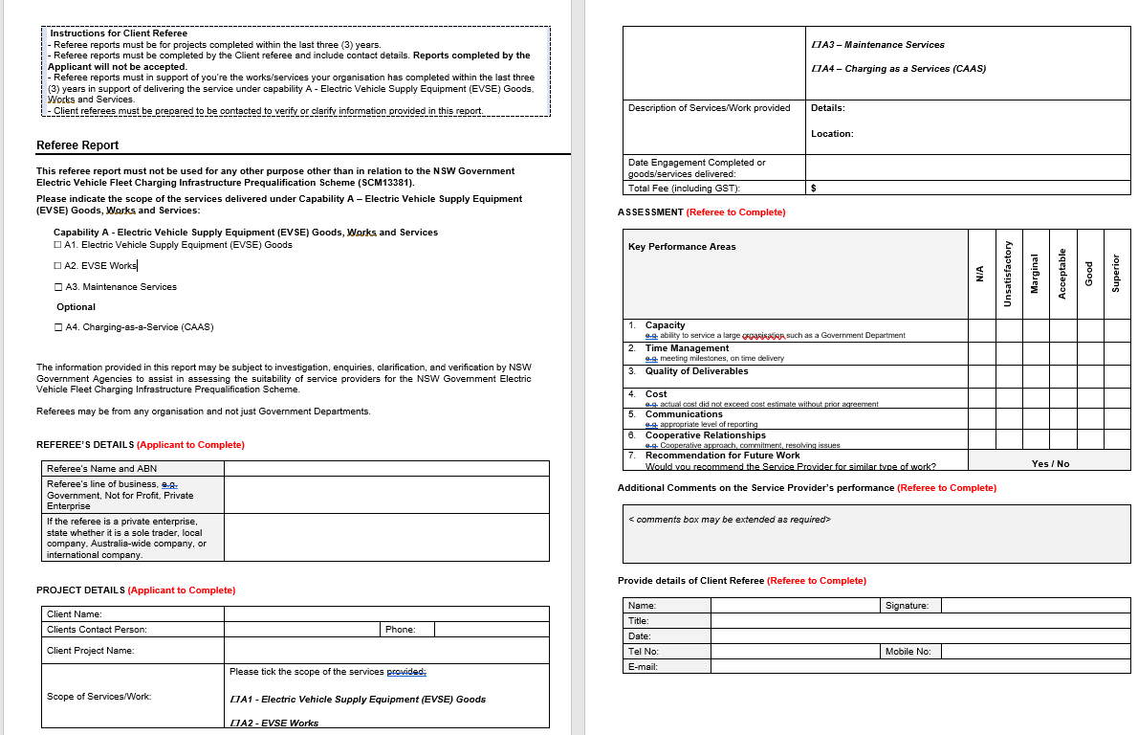
Applicant Referee Reports
The applicant must provide two (2) referee reports in support of the ability to deliver complete scope defined under capability A.
Guide note for Question
1
Review the requirements detailed in the question. Download the Referee Report Template and provide 2 referee reports.
1
1
4
2
Upload the completed template.
Guide Note for completing the template
2
3
To demonstrate the Company has delivered the full scope of Capability A either by itself or others, it is expected all checkboxes of A1/A2/A3 in Section 1.1 are ticked, while A4 is optional.
3
5
4
Please ensure to provide as much details as possible about the reference project
5
Please ensure that the referee completes the key performance area and indicates Yes/No on whether they would recommend your company for similar type work under capability A under the scheme.
Watchpoint:
Applicants that do not provide the information in the form requested and submit two (2) referee reports that support your companies ability to deliver the complete requirements under capability A (A1+A2+A3, (A4 Optional), either directly or via the engagement of 3rd parties will be marked unsuccessful.
6
6
Ensure the referee’s signature is provided. Any name(s) typed in here is not accepted.

Slide 12
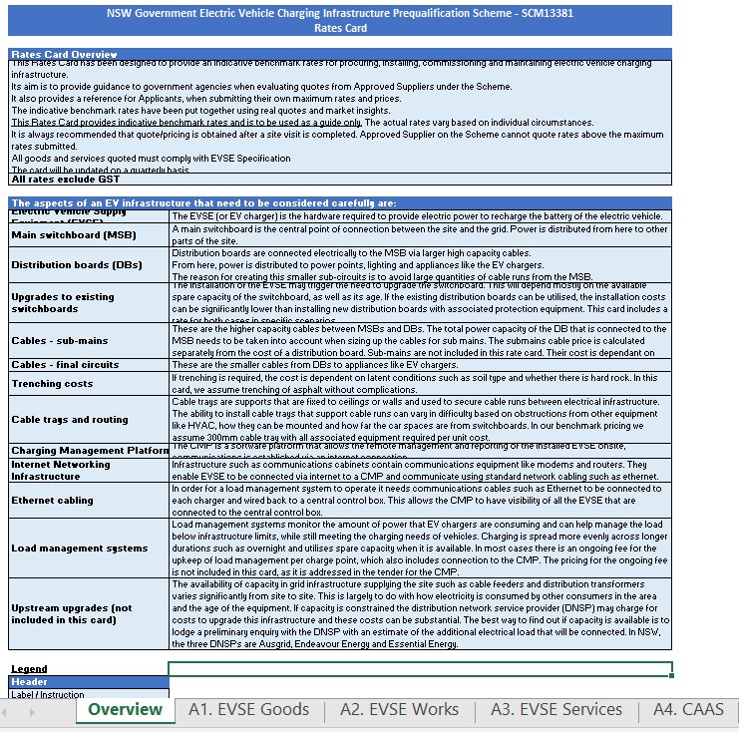
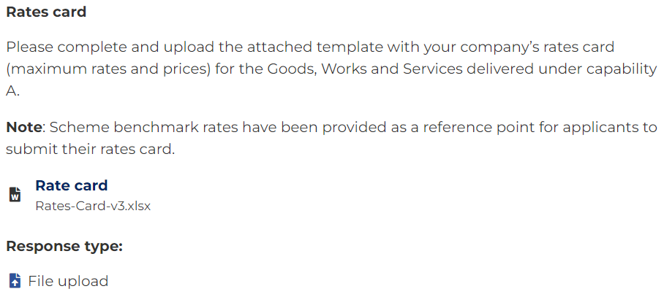
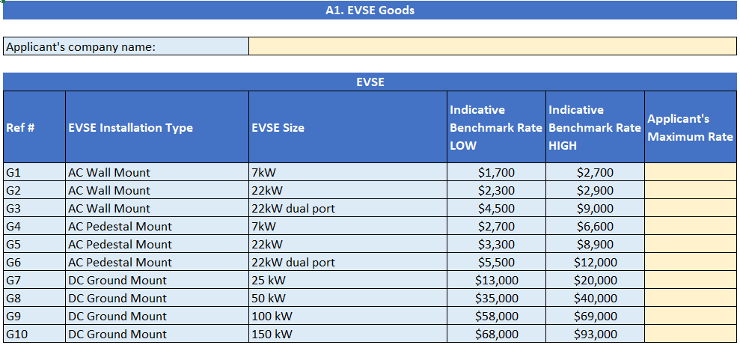
Rates Card
The applicant must provide their rates for the delivery of EVSE Goods, Works & Services under capability A in the templates provided.
1
Guide note for rates card
1
Review the requirements detailed in the question. Download and complete the Rates Card.
1
2
Upload the completed Rates Card template for each tab A1,A2,A3, (A4 optional, only if your organisation has capability).
3
Guide Note for completing the Rates Card template
3
Carefully review the Rates Card Overview section and the definitions of rate items as stipulated in the Rates Card tabs of A1, A2, A3 and A4.
2
4
4
Complete all rates card tabs (A1 , A2 , A3 and (A4 Optional).
5
Note: not all items are to be quoted in maximum rates, some items are to be quoted by estimate rate or estimate number of hours required.
Watchpoint:
Applicants that do not provide the complete response to the rate cards in the form requested to support their ability o deliver the for the complete scope under capability A (A1+A2+A3, (A4 Optional) will be marked as unsuccessful.
5

Slide 13
Insurances
The applicant is not required to submit any certificate of insurance as part of the application process, but agree to hold, purchase and hold if and when requested.
1
Guide note for Question
1
Review the requirements detailed in the question.
Select whether you agree or Do not agree to the question.
2
2
Watchpoint:
Applicants that do not agree to this question will be marked as unsuccessful.

Slide 14
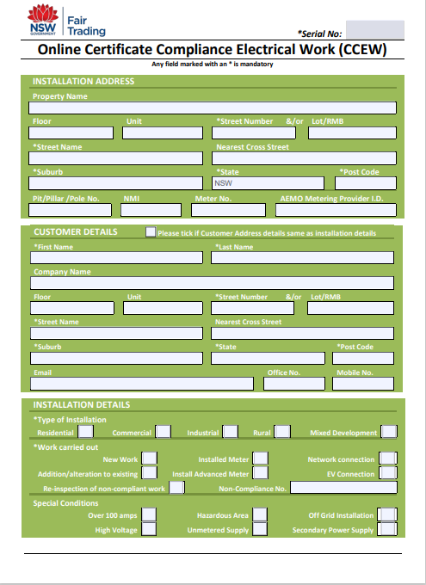
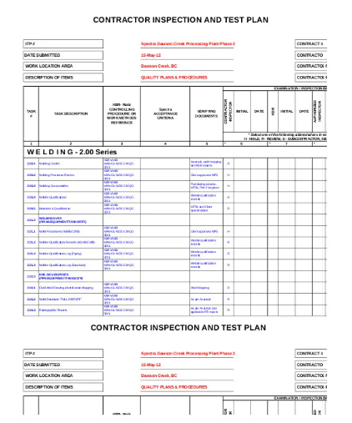
Quality Assurance
The applicant must provide evidence of their ability to have in place the required Quality Assurance controls.
Examples Only
2
1
2
Watchpoint:
Applicants that do not provide the evidence in the form requested will be marked unsuccessful.
Guide note for Question
1
Review the requirements detailed in the question.
2
Upload either
accreditation from a recognised body such as ISO 9001 certificate, or:
1 example of completed site-specific quality inspection and test plan, or
1 example of a Certificate Compliance Electrical Work (CCEW), or
1 example of a Commissioning test report.

Slide 15
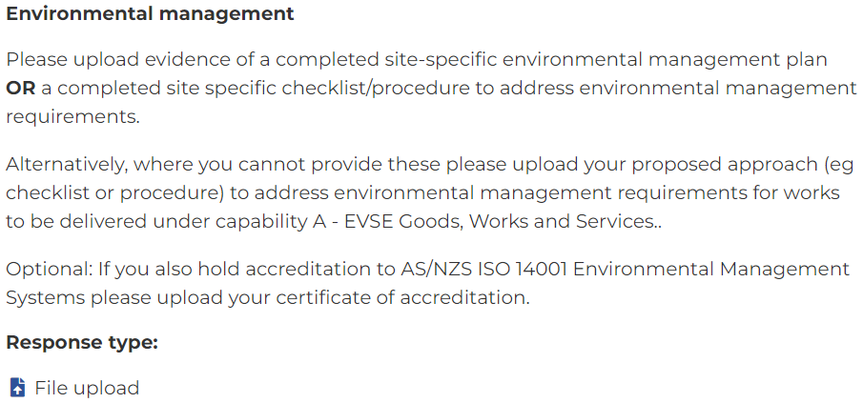
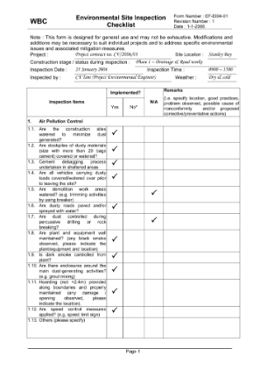
Environmental Management
The applicant must provide evidence of their ability to have in place the required Environmental management controls.
Guide note for Question
1
Example Only
1
Review the requirements detailed in the question.
2
2
Upload evidence of either
Completed site-specific Environmental Management Plan, or
Completed site specific checklist/procedure to address environmental management, or
Provide details of a proposed approach, including any checklists or procedures they will have in place to address environmental management requirements for works to be delivered under Capability A – Electric Vehicle Supply Equipment (EVSE) Goods, Works and Services.
Optional ISO 1400 Environmental Management systems accreditation
2
Watchpoint:
Applicants that do not provide the information in the form requested will be marked unsuccessful.

Slide 16
Other Licenses and Certifications
The applicant and all nominated sub-contractors must hold appropriate licenses and certifications as required by NSW Fair Trading and NSW laws.
1
Guide note for Question
1
Review the requirements detailed in the question.
2
Please select yes or no.
2
Watchpoint:
Applicants that do indicate yest to this question will be marked as unsuccessful.

Slide 17
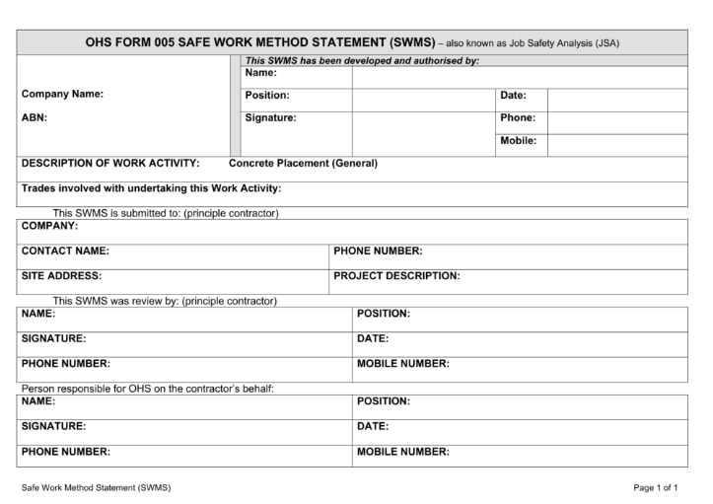
Workplace Health and Safety (WHS) Statutory Obligations
The applicant must provide evidence their ability to have in place the required Workspace Health and Safety (WHS) controls.
Examples Only
Guide note for Question
1
Review the requirements detailed in the question.
2
1
2
Upload evidence of either
any WHS Management System certification, ISO 45001 or AS 4801, or
1 example of a completed safe work method statements
2
Watchpoint:
Applicants that do not provide the information in the form requested will be marked as unsuccessful.

Slide 18
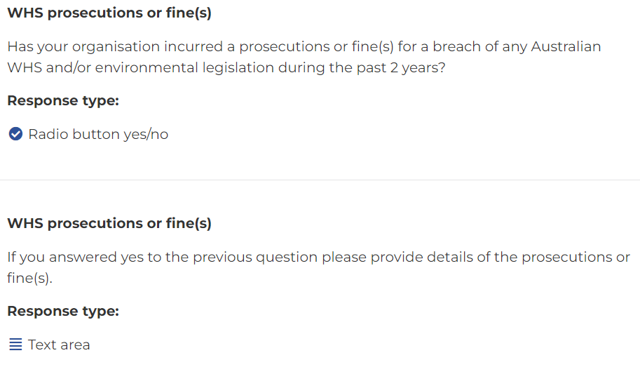
Workplace Health and Safety (WHS) Prosecutions or Fine(s)
The applicant to disclose and provide details (if applicable) of any prosecutions or fines for a breach of Australian WHS and/or environmental legislation.
1
Guide note for Question
1
Review the details requested in the question.
2
2
Please select yes or no the Company incurred any prosecutions or fines during the past 2 years.
If Yes is selected, the applicant must provide details of prosecutions or fines incurred such as incidents, causes, current status and any ramifications.
3
3
Watchpoint:
Applicants that have selected yes and do not provide adequate details of details of prosecutions or fines incurred will be marked as being unsuccessful. The Scheme assessment committee reserves the right not to prequalify an applicant on review and investigation of the information provided.

Slide 19
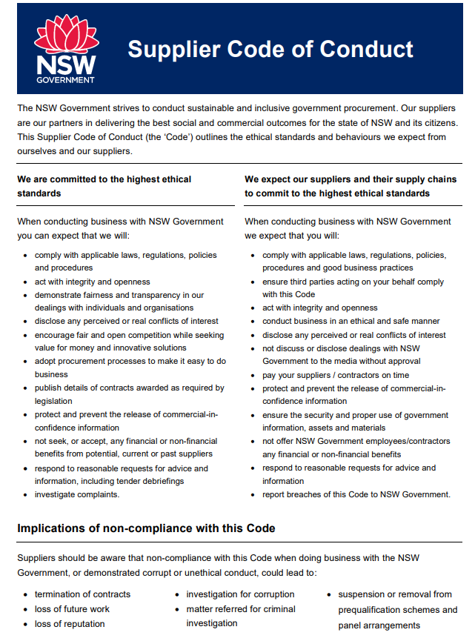
Supplier Code of Conduct
The applicant is to confirm whether the Company will comply with the NSW Government Supplier Code of Conduct.
1
Guide note for Question
1
Review the requirements detailed in the question.
2
Please select Agree or Do not agree
2
Watchpoint:
Applicants that do not agree to the and NSW Government Supplier code of Conduct will be marked as unsuccessful.

Slide 20
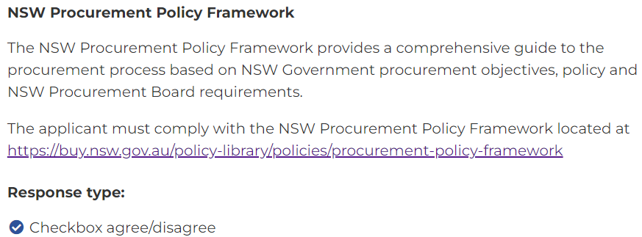
NSW Procurement Policy Framework
The applicant is to confirm whether they comply with the NSW Procurement Policy Framework.
Guide note for Question
1
1
Review the requirements detailed in the question.
1
2
Please select Agree or Do not agree
2
Watchpoint:
Applicants that do not agree to the and NSW Government Procurement Policy Framework will be marked as unsuccessful.

Slide 21
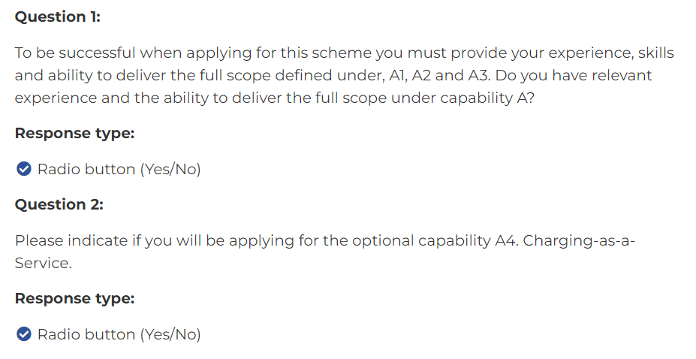
Declaration of Capability Experience
The applicant is to declare the ability to deliver the full scope defined under A1, A2 and A3, and whether applicant will apply for optional A4
1
Guide note for Question
1
Review the requirements detailed in the question.
2
2
Please select yes or no
2
Watchpoint:
Applicants that reply no to Question 1, i.e. do not provide the experience to deliver the full scope of capability A, will be marked unsuccessful.

