Slide 1
Centre-led procurement training and development catalogue
NSW Procurement
October 2026
External

Slide 2

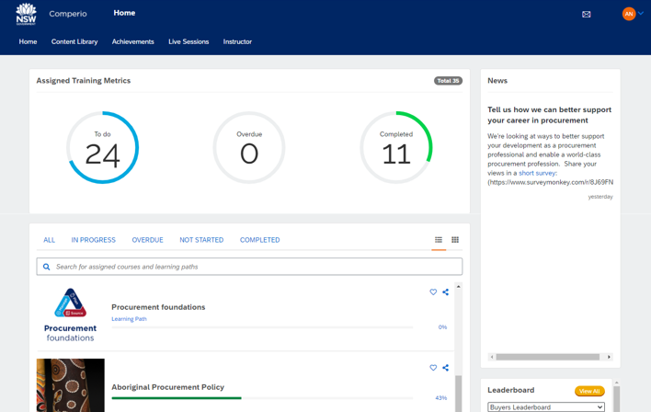
Comperio – NSW Government’s procurement training platform
Who can access it?
NSW Government buyers and procurement professionals
Eligible buyers (e.g. SOCs, local councils and other government jurisdictions)
Suppliers and the general public
Features
Online procurement training (NSW public sector focussed)
Curated content (inc. podcasts and webinars)
Reporting
Procurement job advertisements
Leaderboards
https://training.buy.nsw.gov.au

Slide 3
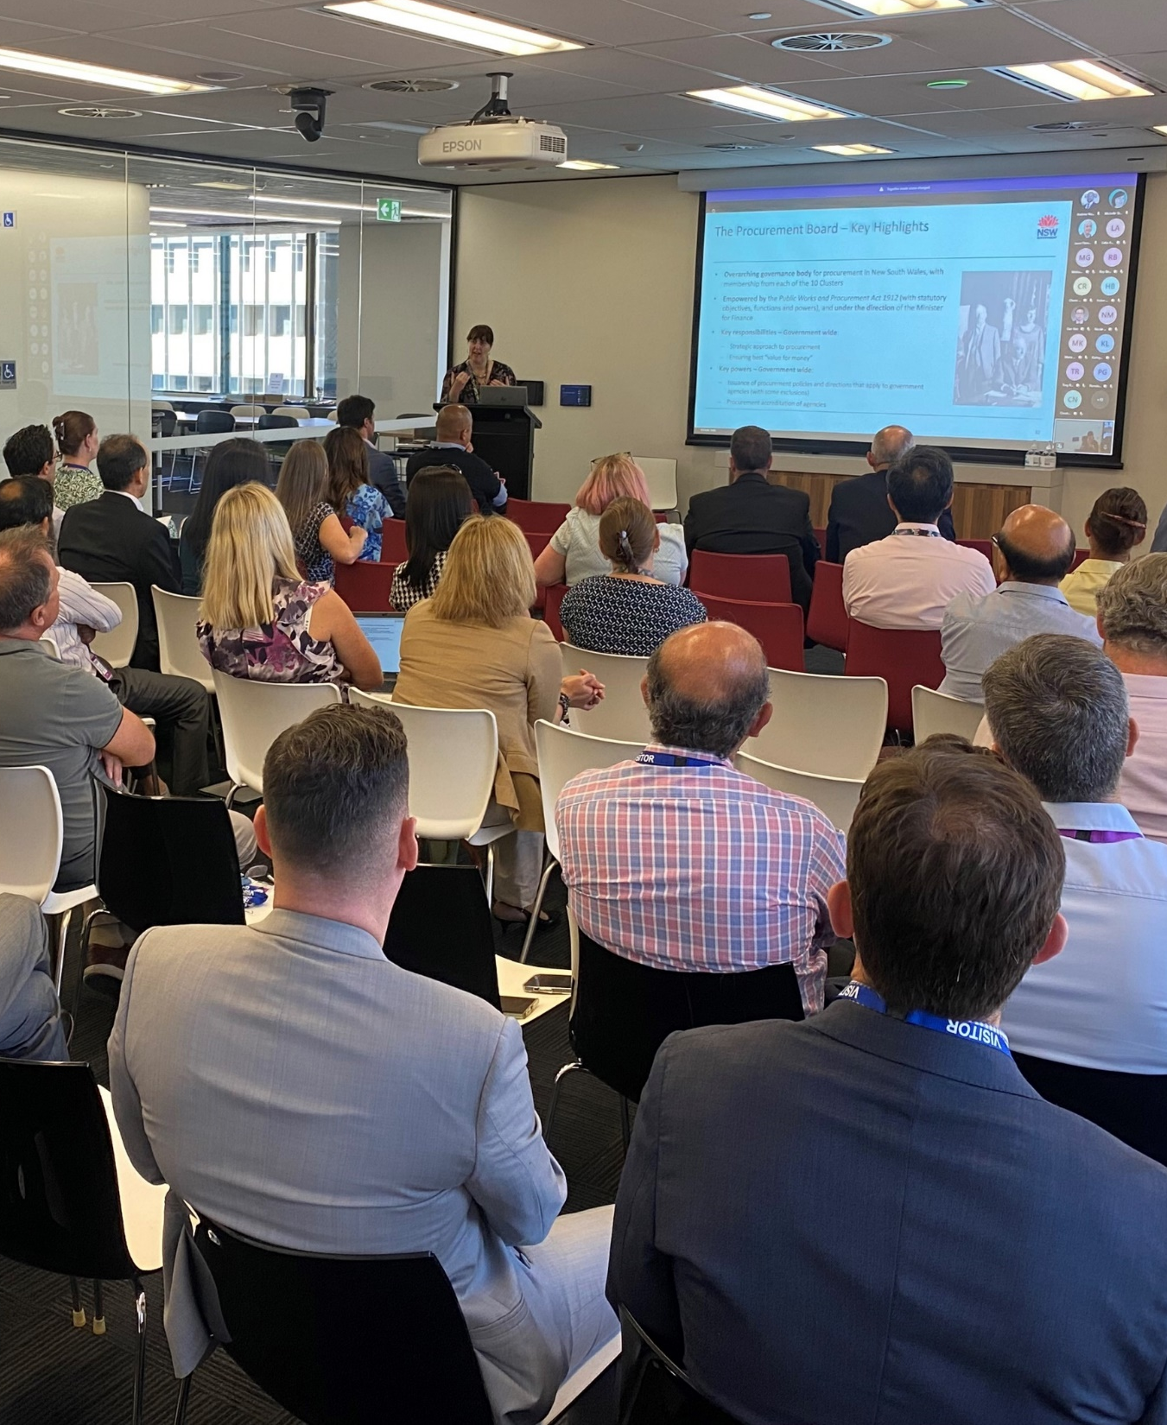
Procurement Professionals Community of Practice
The ComPrac helps procurement professionals working in the NSW public sector build their capability in procurement and contract management.
The community comes together to:
learn about new or changing legislation, policy and procedures
share lessons learned and best practice
hear what’s happening in other agencies, jurisdictions and industry
jointly solve problems, innovate and ideate by seeking advice and leveraging the collective knowledge and expertise of members
connect and network with peers across the sector.
https://www.info.buy.nsw.gov.au/training/community-of-practice

Slide 4

Sustainability subcommunity
The Sustainable Procurement Community of Practice (SustProc CoP) is a subcommunity of the ComPrac, which aims to provide a platform for an exchange of information for advancing sustainability in procurement across agencies.
The SustProc community comes together to:
act as a central repository of information
share lessons learnt from those with practical experience and address shared challenges
provide capability uplift for all attendees in the best interests of sustainable procurement maturity within state government agencies
drive action and innovation by encouraging new projects, pilots and initiatives that promote sustainable procurement.
https://www.info.buy.nsw.gov.au/training/community-of-practice
Notes:
For those interested in enhancing their sustainable procurement knowledge you might like to join the Sustainability sub-community.

Slide 5


Procurement Career Pathways tool
    The Procurement Career Pathways Tool supports the attraction, development and retention of procurement talent in the NSW public sector.
The Tool allows current and future employees to:
    explore roles
    self-assess their skills and capabilities
    get a personalised career plan and upskilling resources.
    05
    32
    16
    150+
    Procurement job families
    Procurement role types
    Other common role types
    Upskilling resources
https://procurementcareerpathways.psc.nsw.gov.au

Slide 6
Recommended procurement learning pathway for NSW public sector employees

Slide 7
Procurement foundations training (learning path)
Learn how to buy low-value, low-risk goods and services in line with the NSW Government's procurement system
Title | Audience and level | What you’ll learn | Duration | Format | Cost
Governance | Level: Foundational Audience: Buyers (All NSW Government employees and eligible buyers) Targets the Foundational-Adept levels of the Procurement and Contract Management (Business Enablers) capabilities in the PSC Capability Framework | Learn how procurement is governed in NSW Government, including approved procurement arrangements and accreditation. Understand how procurement in the NSW public sector is governed, including who is responsible for your agency’s procurement and the role of the NSW Procurement Board, Procurement Leadership Group and NSW Treasury. Understand how your agency’s accreditation status impacts its procurement. Identify approved procurement arrangements that you must use. Identify procurements that are exempt from using approved procurement arrangements. Understand what records you must keep. | 15 mins | Online, Self-paced | Free
NSW Government’s procurement objectives |  | Learn about NSW Government’s five procurement objectives for guiding procurement decisions. Define value for money. Identify how you can promote fair and open competition. Identify how you can help NSW to be the easiest state to do business. Understand how being innovative in your procurement can deliver better outcomes. Understand how sustainable procurement can deliver outcomes that support society, the economy and the environment. | 15 mins

Slide 8
Procurement foundations training (learning path)
Learn how to buy low-value, low-risk goods and services in line with the NSW Government's procurement system
Title | Audience and level | What you’ll learn | Duration | Format | Cost
Procurement legislation and policies | Level: Foundational Audience: Buyers (All NSW Government employees and eligible buyers) Targets the Foundational-Adept levels of the Procurement and Contract Management (Business Enablers) capabilities in the PSC Capability Framework | Learn about your obligations under a range of legislation and policies relating to procurement. Identify your obligations under key legislation and policies related to procurement. Understand how the Procurement Policy Framework can be used as a single source of guidance on government objectives, requirements and rules for procurement. | 10 mins | Online, Self-paced | Free
Planning your procurement |  | Learn how to plan your low value, low risk procurement in line with best practice. Identify the stages of best practice procurement methodology. Analyse the business need and engage your stakeholders. Analyse and engage the market. Finalise your procurement strategy. | 10 mins

Slide 9
Procurement foundations training (learning path)
Learn how to buy low-value, low-risk goods and services in line with the NSW Government's procurement system
Title | Audience and level | What you’ll learn | Duration | Format | Cost
Sourcing | Level: Foundational Audience: Buyers (All NSW Government employees and eligible buyers) Targets the Foundational-Adept levels of the Procurement and Contract Management (Business Enablers) capabilities in the PSC Capability Framework | Learn how to source low value, low risk goods and services in line with best practice. Understand you must be authorised to approach the market. Understand and select the most appropriate type of market approach. Develop an evaluation plan and determine your evaluation criteria. Understand the role and responsibilities of the evaluation team. Declare conflicts of interest. Prepare your documentation and issue the RFX using a procurement system. Understand how to run the tender process. Understand how to evaluate tender responses and select the successful supplier. Understand how to negotiate and award the contract. | 20 mins | Online, Self-paced | Free
Implementing and managing the arrangement |  | Learn about implementing and managing your arrangement, including paying suppliers and your reporting obligations. Understand how to pay suppliers. Understand your reporting and contract disclosure obligations. Foster a positive relationship with the supplier to ensure delivery of procurement outcomes. | 10 mins

Slide 10
Procurement foundations training (learning path)
Learn how to buy low-value, low-risk goods and services in line with the NSW Government's procurement system
Title | Audience and level | What you’ll learn | Duration | Format | Cost
Probity in procurement | Level: Foundational Audience: Buyers (All NSW Government employees and eligible buyers) Targets the Foundational-Adept levels of the Procurement and Contract Management (Business Enablers) capabilities in the PSC Capability Framework | Learn about your obligation to uphold the principles of probity in procurement. Identify and apply probity principles to your procurement. Understand the role of probity advisers and auditors and when you might need to engage them. | 10 mins | Online, Self-paced | Free
Corruption prevention in procurement |  | Learn about your obligation to prevent corruption in procurement. Understand the impacts of corrupt conduct. Define corrupt conduct. Identify procurement outcomes that can result from corrupt conduct. Identify corruption risks in procurement. Understand your obligations in preventing corruption in procurement, including managing conflicts of interest and offers of gifts and benefits. Know how to report corrupt conduct. | 15 mins

Slide 11
Legislative and policy training (learning path)
Learn about your responsibilities under a range of legislation and policies relating to procurement
Title | Audience and level | What you’ll learn | Duration | Format | Cost
GIPA Act 2009 - Contract disclosure requirements | Level: Foundational Audience: Buyers (All NSW Government employees and eligible buyers) | Learn about the responsibilities of government employees to disclose contracts under the GIPA Act. Identify contracts that are mandated for disclosure. Define the classes of contracts and the information to be released for each. Determine disclosure timeframes. Recognise where information is to be published. | 30 mins | Online, Self-paced | Free
Aboriginal Procurement Policy training for buyers | Level: Foundational Audience: Buyers (All NSW Government employees and eligible buyers) | Learn how the Aboriginal Procurement Policy supports NSW Government's commitment to growing NSW’s First Economy. Apply the requirements for Aboriginal participation strategies. Understand contract target arrangements. Define addressable spend. Implement reporting requirements. | 50 mins | Online, Self-paced | Free

Slide 12
Legislative and policy training (learning path)
Learn about your responsibilities under a range of legislation and policies relating to procurement
Title | Audience and level | What you’ll learn | Duration | Format | Cost
An Introduction to modern slavery and your obligations | Level: Foundational Audience: Buyers (All NSW Government employees and eligible buyers) | Learn about modern slavery and your obligations under NSW laws to manage modern slavery risks in operations and supply chains. Understand what modern slavery is Understand the role of the NSW Anti-slavery Commissioner Identify how modern slavery risks can arise Recognise your modern slavery due diligence and reporting obligations under NSW state law | 30 mins | Online, Self-paced | Free
Manage modern slavery risks in your organisation | Level: Intermediate-Advanced Audience: Those operating at a whole-of-organisation level in covered entities | Learn about your obligations and take reasonable steps to manage modern slavery risks in organisational-level operations and activities. Foundational concepts for managing modern slavery risk Commit to effectively address modern slavery risks Remedy modern slavery harms Report modern slavery and your entity’s responses to modern slavery risks Improve the effectiveness of modern slavery risk management efforts (For senior management, legal, human resources, risk, policy and procurement practitioners) | 180 mins | Online, Self-paced | Free

Slide 13
Legislative and policy training (learning path)
Learn about your responsibilities under a range of legislation and policies relating to procurement
Title | Audience and level | What you’ll learn | Duration | Format | Cost
Manage modern slavery risks in procurement | Level: Intermediate-Advanced Audience: Procurement professionals in covered entities | Learn about your obligations and take reasonable steps to manage modern slavery risks in procurement activities and supply-chains. Foundational concepts for managing modern slavery risk Manage modern slavery risk management in procurement planning Minimise modern slavery risk in sourcing activities Manage contracts and suppliers to address modern slavery risks Report responses to modern slavery risks in procurement Improve the effectiveness of modern slavery risk management efforts | 180 mins | Online, Self-paced | Free
Enforceable Procurement Provisions Direction 2019 | Level: Foundational Audience: Buyers (All NSW Government employees and eligible buyers) | Learn who must comply with the EPP Direction, what thresholds apply and the required market approach. Understand what International procurement agreements (IPAs) are and your obligations Apply the general rules for covered procurements Identify and follow the complaints management process for covered procurement complaints. | 60 mins | Online, Self-paced | Free

Slide 14
Legislative and policy training (learning path)
Learn about your responsibilities under a range of legislation and policies relating to procurement
Title | Audience and level | What you’ll learn | Duration | Format | Cost
Public Interest Disclosures | Level: Foundational Audience: Buyers (All NSW Government employees and eligible buyers) | Learn about your responsibilities under the Public Interest Disclosures Act 2022 (PID Act), how to report serious wrongdoing and what will happen when you do. Identify when a report of serious wrongdoing is a PID Know what to do when you receive a report Help foster a culture where reporters feel confident in coming forward. | 75 mins | Online, Self-paced | Free
Public Interest Disclosures (PIDs) for people leaders | Level: Foundational Audience: Buyers (All NSW Government employees and eligible buyers) | Learn about your responsibilities under the Public Interest Disclosures Act 2022 (PID Act) as a people leader, including promoting a speak-up culture and how to act on reports of wrongdoing. Identify when a report of serious wrongdoing is a PID Know what to do when you receive a report Help foster a culture where reporters feel confident in coming forward. | 30 mins | Online, Self-paced | Free

Slide 15
Legislative and policy training (learning path)
Learn about your responsibilities under a range of legislation and policies relating to procurement
Title | Audience and level | What you’ll learn | Duration | Format | Cost
Environmentally sustainable procurement | Level: Intermediate-Advanced Audience: Procurement professionals | Consider environmental sustainability in the way you plan, source and manage the procurement of goods, services and construction. Undertake demand analysis Identify environmental risks and opportunities in procurement Undertake early market engagement for environmental sustainability Complete whole-of-life costing Integrate environmental sustainability in contracts, KPIs, tender evaluation and negotiations Manage suppliers to enhance environmental sustainability outcomes Apply recycled content requirements in procurement, including the ‘if not, why not’ approach under NSW Government policy Identify opportunities to include recycled content when planning, sourcing and managing procurements. | 105 mins | Online, Self-paced | Free

Slide 16
Applied procurement and contracting training
Learn to undertake or manage low-medium risk/value procurement and contracting activities
Title | Audience and level | What you’ll learn | Duration | Format | Cost
Applied procurement and contracting | Level: Intermediate Audience: Buyers (All NSW Government employees and eligible buyers) Builds on the Procurement foundations training | This course covers the complete lifecycle of a low-medium risk/value procurement from initial planning activities through to closing it out. Apply NSW Government regulatory and policy framework to a procurement activity. Plan a procurement. Approach the market. Conduct a procurement. Manage a contract. Apply appropriate probity to a procurement. | 2 days | In-person or online, instructor-led | $1350

Slide 17
Procurement skills booster training (learning path)
Develop your strategic procurement capabilities as a procurement professional
Title | Audience and level | What you’ll learn | Duration | Format | Cost
Commercial negotiation | Level: Intermediate Audience: Procurement professionals (NSW Government employees and eligible buyers) Targets levels 1 and 2 in the Procurement Professionals Capability Set Builds on the Procurement foundations and Applied Procurement and Contracting training | Learn to plan, conduct and analyse the outcomes of commercial negotiations to achieve business objectives. Identify benefits and common types of negotiation in government procurement. Identify negotiation styles, ploys and tactics. Identify key stages of negotiation. Plan, conduct and conclude negotiations. Respond to and deal with negotiation issues. | 30 mins | Online, Self-paced | Free
Contract management |  | Learn to effectively manage contracts to ensure goods and services are delivered as agreed. Plan to manage a contract. Start up a contract. Build and manage effective working relationships with suppliers and stakeholders. Monitor and manage contract performance. Administer contracts. Close a contract. | 60 mins

Slide 18
Procurement skills booster training (learning path)
Develop your strategic procurement capabilities as a procurement professional
Title | Audience and level | What you’ll learn | Duration | Format | Cost
Supplier relationship management | Level: Intermediate Audience: Procurement professionals (NSW Government employees and eligible buyers) Targets levels 1 and 2 in the Procurement Professionals Capability Set Builds on the Procurement foundations and Applied Procurement and Contracting training | Learn to establish constructive and innovative strategic relationships based on driving value through appropriate long-term relationships. Segment suppliers and determine the appropriate type of relationship needed. Develop appropriate supplier relationships. Assess impacts on suppliers and work to eliminate areas of unnecessary costs. Track and monitor benefits through supplier relationships. | 30 mins | Online, Self-paced | Free
Procurement risk management |  | Learn to effectively identify, assess and mitigate procurement risks. Identify requirements for risk management in procurement Communicate and consult with key stakeholders about risk Identify, analyse and evaluate key risks Develop and implement risk treatments Monitor and review risks | 30 mins

Slide 19
Procurement skills booster training (learning path)
Develop your strategic procurement capabilities as a procurement professional
Title | Audience and level | What you’ll learn | Duration | Format | Cost
Managing foreign exchange risk | Level: Intermediate Audience: Procurement professionals (NSW Government employees and eligible buyers) Targets levels 1 and 2 in the Procurement Professionals Capability Set Builds on the Procurement foundations and Applied Procurement and Contracting training | Learn to effectively manage foreign exchange (FX) risk when buying goods and services: Comply with your obligations for managing FX risk. Identify and report FX risk in procurement activities. Understand the concept of FX risk mitigation through hedging. Manage FX risk with the assistance of TCorp. | 20 mins | Online, Self-paced | Free
Specification writing |  | Learn to effectively develop specifications to ensure supply options are not limited: Identify the role of specifications. Distinguish between functional, performance, and technical specifications. Collaborate with end users to ensure procured goods and services are accessible and fit for purpose. Consider social, economic, environmental and sustainability objectives in specification development. Understand the consequences of poor specifications. Develop a well written specification using the SMART approach. | 30 mins

Slide 20
Procurement skills booster training (learning path)
Develop your strategic procurement capabilities as a procurement professional
Title | Audience and level | What you’ll learn | Duration | Format | Cost
Procurement evaluations | Level: Intermediate Audience: Procurement professionals (NSW Government employees and eligible buyers) Targets levels 1 and 2 in the Procurement Professionals Capability Set Builds on the Procurement foundations and Applied Procurement and Contracting training | Effective evaluation is key to ensuring procurement decisions remain fair, transparent, and aligned with organisational goals. From assessing technical specifications and pricing models to verifying compliance requirements, your ability to critically analyse submissions plays a vital role in achieving value for money and managing risk. This module is designed to build your expertise and confidence in evaluating supplier proposals, equipping you with practical skills to apply consistent and informed judgment throughout the process. | 60 mins | Online, Self-paced | Free
Supplier debriefings |  | Post tender debriefing is the process of providing feedback to suppliers that have responded to a procurement activity. Debriefs enhance supplier relationships, promote transparency and accountability, and foster learning and improvement. This course covers the benefits, principles, and best practices of debriefing, and some common challenges and pitfalls to avoid. It will also provide practical tips and tools for planning, conducting, and documenting debriefs. | 30 mins

Slide 21
Procurement skills booster training (learning path)
Develop your strategic procurement capabilities as a procurement professional
Title | Audience and level | What you’ll learn | Duration | Format | Cost
Supplier Due Diligence | Level: Intermediate Audience: Procurement professionals (NSW Government employees and eligible buyers) Targets levels 1 and 2 in the Procurement Professionals Capability Set Builds on the Procurement foundations and Applied Procurement and Contracting training | Learn to effectively make informed decisions, minimise risks, and help build a resilient and efficient supply chain: Identify the benefits of supplier due diligence Conduct supplier due diligence in each stage of the procurement process | 20 mins | Online, Self-paced | Free
 |  | More coming soon.

Slide 22
Procurement and contracting qualifications
Nationally recognised training for public sector procurement professionals
Title | Audience and level | What you’ll learn | Duration | Format | Cost
Diploma of procurement and contracting | Level: Advanced Audience: professional procurement and contract management officers who are experienced in NSW public sector procurement | This course looks at planning, sourcing and managing complex procurement activities. It includes evaluating offers, negotiating and performance managing complex contracts. Establish a governance framework for a complex procurement. Develop a complex procurement plan. Manage risk in a procurement. Manage a complex procurement activity. Evaluate a complex procurement. Negotiate successful procurement outcomes. Manage a complex contract. Manage contractor performance. | 9 days | In-person or online, instructor-led | $5900

Slide 23
Procurement and contracting qualifications
Nationally recognised training for public sector procurement professionals
Title | Audience and level | What you’ll learn | Duration | Format | Cost
Advanced diploma of procurement and contracting | Level: Advanced Audience: Suitable for experienced procurement professionals wanting to enhance their strategic management knowledge and skill base | This course focuses on the skills to manage the procurement function within an agency, or to develop agency policies, processes and procurement capability. Develop organisational procurement plans. Strategically analyse agency procurement spend by category. Direct and manage continuous improvement and change in the procurement function. Develop opportunities for coordinated procurement within and across agencies. Manage strategic procurement negotiations. Manage strategic procurement risk. Strategically direct the management of contracts across an agency. | 9 days | In-person or online, instructor-led | $5900

Slide 24
Other procurement training for buyers
Title | Audience and level | What you’ll learn | Duration | Format | Cost
Procurement Analytics | Level: Foundational Audience: Buyers (All NSW Government employees and eligible buyers) | Learn how to access and analyse procurement data to improve business objectives and outcomes. Understand the analytics framework and importance of visual data Use Spend Cube Online to access and export data to answer questions on government spend Use Power BI to analyse and present data in easy to understand formats. | 70 mins | Online, Self-paced | Free
Accessibility in digital procurement | Level: Foundational Audience: Buyers (All NSW Government employees and eligible buyers) | Learn how to buy digital products and services that are accessible to everyone, regardless of age, ability, situation or circumstance. Identify accessibility requirements in procurement Understand why it is important Buy accessible digital products and services everyone can use. | 45 mins | Online, self-paced | Free

Slide 25
Other procurement training for buyers
Title | Audience and level | What you’ll learn | Duration | Format | Cost
An introduction to business cases, cost-benefit analysis and evaluation | Level: Intermediate-advanced Audience: NSW Government employees involved in developing, reviewing or advising on business cases, cost-benefit analyses and evaluation | Learn about the NSW Government Investment Framework and the basics of business cases, cost-benefit analysis, and evaluation. Understand the purpose and stages of the NSW Investment Framework Understand the role of NSW Treasury and when to engage Treasury during business case development Understand business case development Understand cost benefit analysis Develop monitoring and evaluation plans | 40 mins | Online, Self-paced | Free

Slide 26
Resource hubs
Curated content relating to procurement capabilities and topics, including podcasts, videos, knowledge articles and more
Title | Audience and level | What you’ll learn | Duration | Format | Cost
Procurement resource hubs | Level: Foundational-advanced Audience: Procurement professionals | Topics include: Australasian Procurement and Construction Council resources Capability and Career Development Category Management CIPS exam revision Contract Management Innovation Negotiation Procurement Analytics Procurement Planning Procurement Technology and Digitisation Risk Management Social Outcomes and Sustainable Procurement Strategic Sourcing Supplier Relationship Management | N/A | Online, Self-paced | Free

Slide 27
Resource hubs
Curated content relating to procurement capabilities and topics, including podcasts, videos, knowledge articles and more
Title | Audience and level | What you’ll learn | Duration | Format | Cost
Resource Hub: Procurement Professionals ComPrac | Level: Foundational-advanced Audience: Members of the Procurement Professionals Community of Practice | A resource centre for members of the Procurement Professionals Community of Practice. Join the Procurement Professionals Community of Practice to get access to this resource hub. | N/A | Online, Self-paced | Free
Resource Hub: Sustainable Procurement Community of Practice (SustProc CoP) | Level: Foundational- advanced Audience: Members of the SustProc CoP | A resource centre for members of the Procurement Professionals Community of Practice. Join the SustProc CoP to get access to this resource hub. | N/A | Online, self-paced | Free

Slide 28
Systems training
Learn how to use procurement systems
Title | Audience and level | What you’ll learn | Duration | Format | Cost
Tenders training for buyers | Level: Foundational Audience: NSW Government employees who use Tenders to issue, manage and award tenders from suppliers | Learn how to create and publish a market opportunity and access supplier responses. Register on buy NSW Use Supplier Hub to find suppliers and create supplier shortlists Create, maintain and complete opportunities in Tenders | 3 hrs | Online, Self-paced | Free

Slide 29
Construction procurement training
Learn about contractual frameworks for construction
Title | Audience and level | What you’ll learn | Duration | Format | Cost
GC21 standard form contract training | Level: Foundational Audience: Suppliers, contract managers and contractors who want to gain a sound understanding of the GC21 construction contract | A one-day course for buyers and suppliers to understand the GC21 contract used for construction works valued over $1 million. Understand contract structure and content. Understand key features. Apply specific contract clauses. | 1 day | In-person, instructor-led | $600 (GST included)

Slide 30
Construction procurement training
Learn about contractual frameworks for construction
Title | Audience and level | What you’ll learn | Duration | Format | Cost
MW21 standard form contract training | Level: Foundational Audience: Suppliers, contract managers and contractors who want to gain a sound understanding of the MW21 construction contract for works under $1 million. | A course for buyers and suppliers on how to understand the MW21 contractual framework for construction works under $1 million. understand contract structure and content. understand key features. apply specific contract clauses. | 1 day | In-person, instructor-led | $600 (GST included)

Slide 31
Supplier training
Training for suppliers
Title | Audience and level | What you’ll learn | Duration | Format | Cost
Winning business and selling to the NSW Government | Level: Foundational Audience: Suppliers | Learn how to tender for NSW Government contracts and local government opportunities. Get business ready. Find opportunities. Sell to government. Manage contracts for success. | 2 hrs | Online, Self-paced | Free
Aboriginal Procurement Policy training for suppliers | Level: Foundational Audience: suppliers to NSW Government | Learn how the Aboriginal Procurement Policy (APP) drives demand for and growth of Aboriginal businesses. Apply the requirements for Aboriginal participation strategies Understand contract target arrangements Implement reporting requirements. | 50 mins | Online, Self-paced | Free

Slide 32
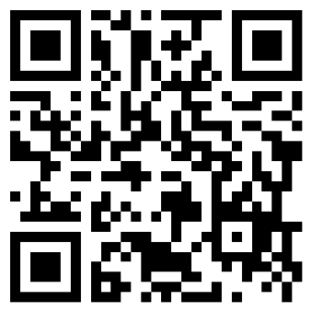
Tell us what you need
Tell us:
what ComPrac event topics and speakers you’d like
about yours (or your agency group’s) training needs and what capability gaps we should address.
You can also contact the NSW Procurement Capability team at NSWP_Capability@treasury.nsw.gov.au
https://forms.office.com/r/sgMwgZ97PL

